Slide 1


An Enhanced Data Security Algorithm using Novel Approach

Slide 2
What is Information?
Information is associated with data and knowledge, as information is data in context and with meaning attached. Data represents the values attributed to parameters, and knowledge signifies understanding of an abstract or concrete concept

Slide 3
Why Encryption?
Encryption, is the process of changing information in such a way as to make it unreadable by anyone except those possessing special knowledge (usually referred to as a "key") that allows them to change the information back to its original, readable form.

Slide 4
why is it important?
Encryption is important because it allows you to securely protect data that you don't want anyone else to have access to. Businesses use it to protect corporate secrets, governments use it to secure classified information, and many individuals use it to protect personal information to guard against things like identity theft.

Slide 5
The two Major Players?
AES
RSA

Slide 6
AES
Advanced Encryption Standard (AES)
Three different key lengths: 128, 192 and 256 bits.
AES is a Symmetric-key algorithm.

Slide 7
RSA
RSA (Rivest–Shamir–Adleman)
Two keys (Public and Private)
Asymmetric-key Algorithm

Slide 8
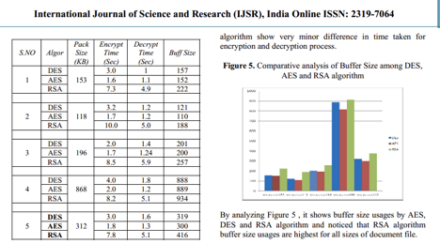
Time chart

Slide 9
How we are Better..

Slide 10
Time chart

Slide 11
Our Advantage over AES and RSA
Variable Key size
Lesser Execution Time
The Triangle Bond
Notes:
AES. 1x10^78
Namma 4x10^87

Slide 12
Triangle Bond
Cipher text
Algorithm
Key

Slide 13
Our Improvements
Version 1
Version 2
Version 3
Version 4 ( dropped )
Version 5 ( dropped )
Version 6
Version 7 ( Future Enhancement )

Slide 14
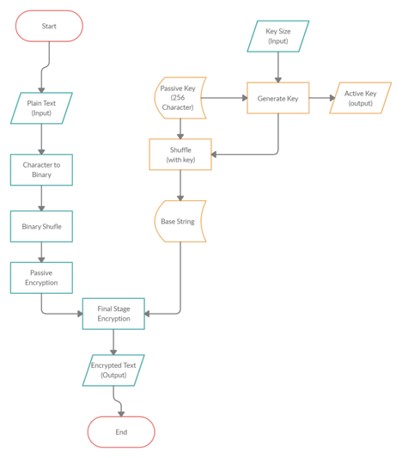
V3 ( Encryption )

Slide 15
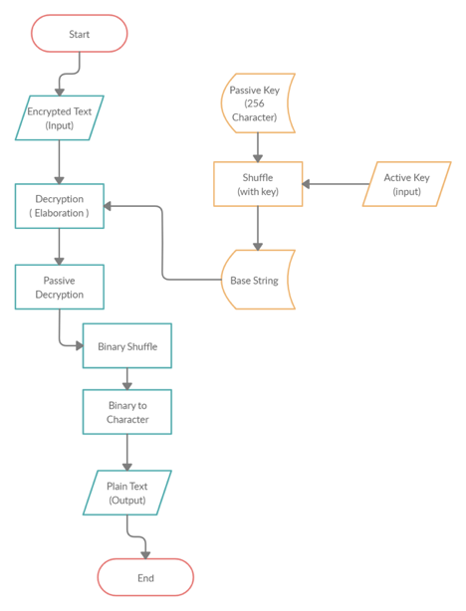
V3 ( Decryption )

Slide 16
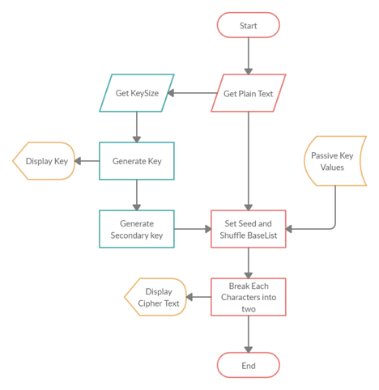
V6 ( Encryption )

Slide 17
Breaking into two
Constant number 128
Lets take a number 215
215/128 = 1
215%128 = 87
So the number 215 is broken into 1 and 87

Slide 18
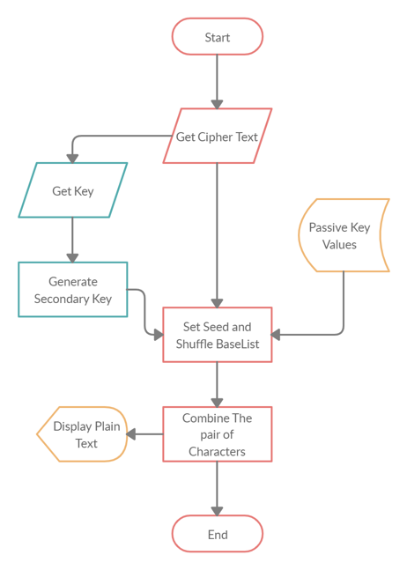
V6 ( Decryption )

Slide 19
Why we need to improve ?

Slide 20
Highlights
Completeness
Avalanche effect
Known Cipher text attack not possible

Slide 21
Who Are Going to Use Cryptography

Slide 22
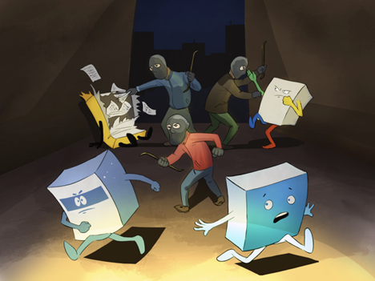

Slide 23
Who Are Going to Use Cryptography
Military ( eg. US )
IT Industries (Eg: Zoho)
Government (Eg: Aadhar)
Businesses use it to protect corporate secrets

Slide 24
THANK YOU

